Slide 1
Satisfiability Modulo Theories
Nikolaj Bjørner
Microsoft Research
Marktoberdorf
August 14, 2015

Slide 2
Lectures
Mon: An Introduction to SMT with Z3
Wed: Algorithmic underpinnings of SAT/SMT
Thu: Theories, Solvers and Applications
Fri: Theory Combination, an Application

Slide 3
Summary so far
Models
Conflict Resolution
Modern SAT solving architecture:
cooperating Model & Proof search
DPLL(T) architecture:
SAT: case splits, Theory solver: check conjunctions
Theories:
Proofs
Uninterpreted functions | Union Find + Congruence Closure
Arithmetic | Network Flow Algorithms, Simplex, CAD
Arrays | Selective axiom instantiation. Reduction to Uninterpreted functions
Bit-vectors | Reduction to SAT

Slide 4
This Lecture
Combining Theories
Network Verification:
An application of Z3 in Azure, SDN, …
As a case study in customizing an SMT solver for an application domain.

Slide 5
Combining THeories

Slide 6

Combining Theories
In practice, we need a combination of theories.
b + 2 = c and f(select(store(a,b,3), c-2)) ≠ f(c-b+1)
A theory is a set (potentially infinite) of first-order sentences.
Main questions:
Is the union of two theories T1 ∪ T2 consistent?
Given a solvers for T1 and T2, how can we build a solver for
T1 ∪ T2?

Slide 7
A Combination History
Foundations
Efficiency using rewriting
1979 Nelson, Oppen - Framework
1996 Tinelli & Harindi. N.O Fix
2000 Barrett et.al N.O + Rewriting
2002 Zarba & Manna. “Nice” Theories
2004 Ghilardi et.al. N.O. Generalized
1984 Shostak. Theory solvers
1996 Cyrluk et.al Shostak Fix #1
1998 B. Shostak with Constraints
2001 Rueß & Shankar Shostak Fix #2
2004 Ranise et.al. N.O + Superposition
2001: Moskewicz et.al. Efficient DPLL made guessing cheap
2006 Bruttomesso et.al. Delayed Theory Combination
2007 de Moura & B. Model-based Theory Combination
… 2015 Ringeissen, 2013 Jovanovic, 2007 Ganesh, overlapping, polite, shiny, etc.

Slide 8
Disjoint Theories
Two theories are disjoint if they do not share function/constant and predicate symbols.
= is the only exception.
Example:
The theories of arithmetic and arrays are disjoint.
Arithmetic symbols: {0, -1, 1, -2, 2, …, +, -, *, >, <, ≥, ≤}
Array symbols: { select, store }

Slide 9
Purification
It is a different name for our “naming” subterms procedure.
b + 2 = c, f(select(store(a,b,3), c-2)) ≠ f(c-b+1)
b + 2 = c, v₆ ≠ v₇
v₁ ≡ 3, v₂ ≡ store(a, b, v₁), v₃ ≡ c-2, v₄ ≡ select(v₂, v₃),
v₅ ≡ c-b+1, v₆ ≡ f(v₄), v₇ ≡ f(v₅)

Slide 10
Purification
It is a different name for our “naming” subterms procedure.
b + 2 = c, f(select(store(a,b,3), c-2)) ≠ f(c-b+1)
b + 2 = c, v₆ ≠ v₇
v₁ ≡ 3, v₂ ≡ store(a, b, v₁), v₃ ≡ c-2, v₄ ≡ select(v₂, v₃),
v₅ ≡ c-b+1, v₆ ≡ f(v₄), v₇ ≡ f(v₅)
b + 2 = c, v₁ ≡ 3, v₃ ≡ c-2, v₅ ≡ c-b+1,
v₂ ≡ store(a, b, v₁), v₄ ≡ select(v₂, v₃),
v₆ ≡ f(v₄), v₇ ≡ f(v₅), v₆ ≠ v₇

Slide 11
Stably Infinite Theories
A theory is stably infinite if every satisfiable QFF is satisfiable in an infinite model.
EUF and arithmetic are stably infinite.
Bit-vectors are not.

Slide 12
Important Result
The union of two consistent, disjoint, stably infinite theories is consistent.

Slide 13
Convexity
A theory T is convex iff
for all finite sets S of literals and
for all a₁ = b₁∨ … ∨ a_{n} = b_{n}
S implies a₁ = b₁∨ … ∨ a_{n} = b_{n}
iff
S implies a_{i} = b_{i} for some 1 ≤ i ≤ n

Slide 14
Convexity: Results
Every convex theory with non trivial models is stably infinite.
All Horn equational theories are convex.
formulas of the form s₁ ≠ r₁∨ … ∨ s_{n} ≠ r_{n} ∨ t = t’
Linear rational arithmetic is convex.

Slide 15
Convexity: Negative Results
Linear integer arithmetic is not convex
1 ≤ a ≤ 2, b = 1, c = 2 implies a = b ∨ a = c
Nonlinear arithmetic
a² = 1, b = 1, c = -1 implies a = b ∨ a = c
Theory of bit-vectors
Theory of arrays
c₁ = select(store(a, i, c₂), j), c₃ = select(a, j)
implies c₁ = c₂ ∨ c₁ = c₃

Slide 16
Combination of non-convex theories
EUF is convex (O(n log n))
IDL is non-convex (O(nm))
EUF ∪ IDL is NP-Complete
Reduce 3CNF to EUF ∪ IDL
For each boolean variable p_{i} add 0 ≤ a_{i} ≤ 1
For each clause p₁ ∨ ¬p₂ ∨ p₃ add
f(a₁, a₂, a₃) ≠ f(0, 1, 0)

Slide 17
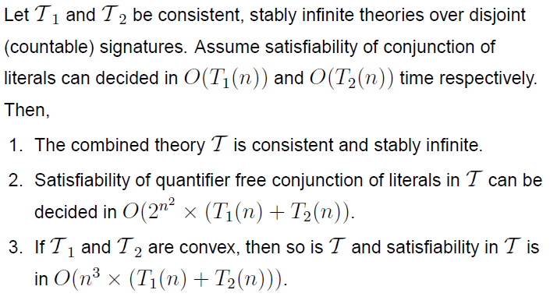
Nelson-Oppen Combination

Slide 18
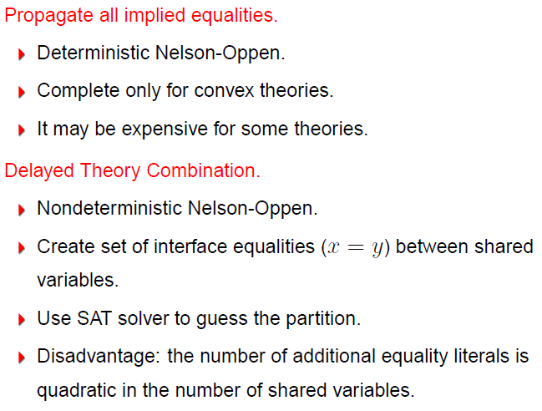
Combining Procedures in Practice

Slide 19
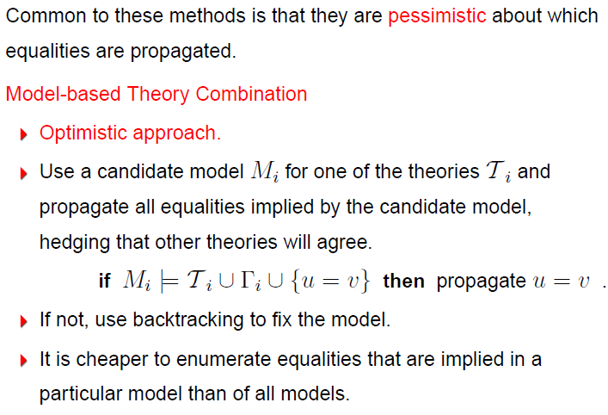
Combining Procedures in Practice

Slide 20
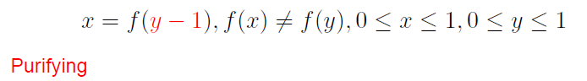
Example

Slide 21
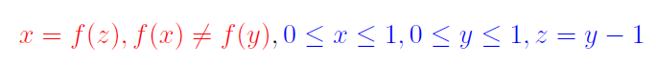
Example

Slide 22
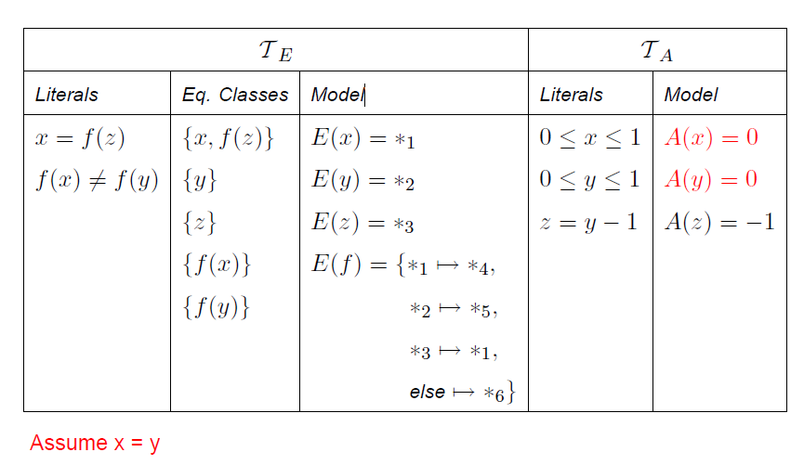
Example

Slide 23
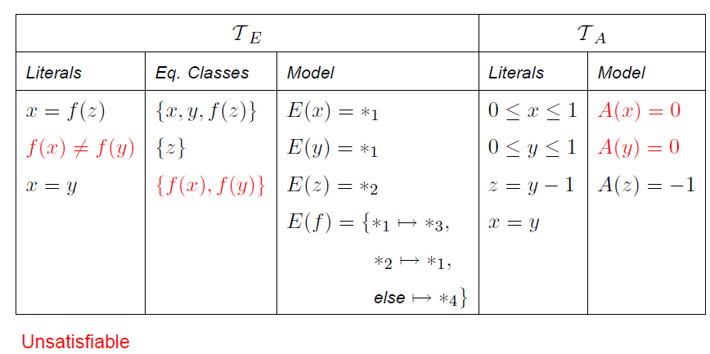
Example

Slide 24
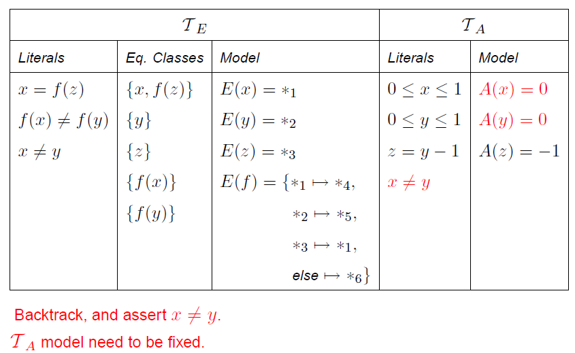
Example

Slide 25
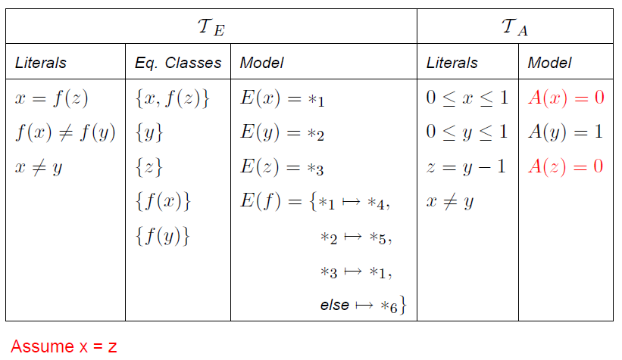
Example

Slide 26
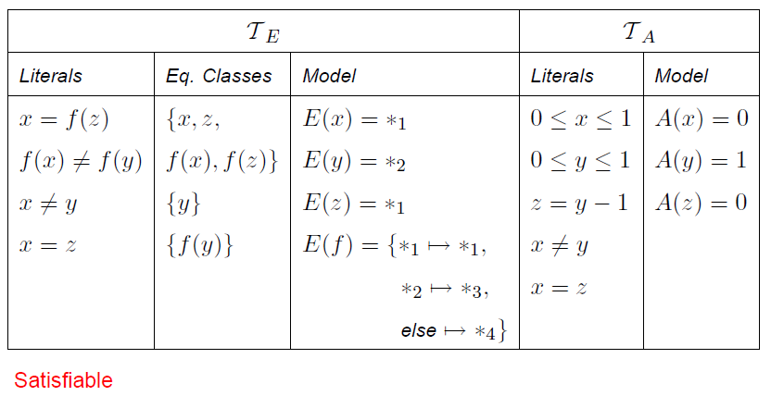
Example

Slide 27
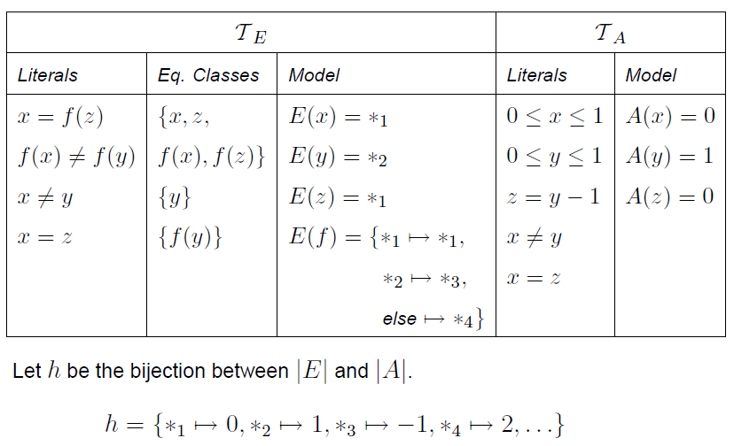
Example

Slide 28
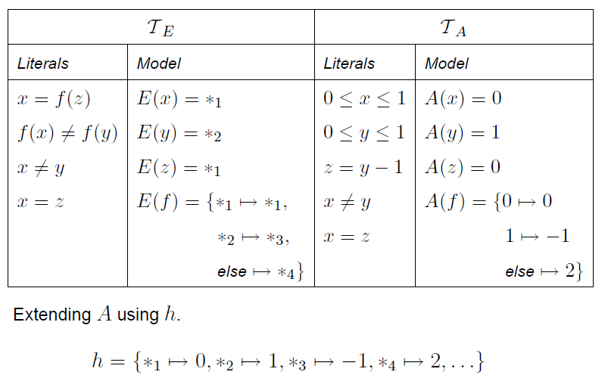
Example

Slide 29
Network Verification with SecGuru

Slide 30

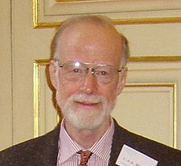
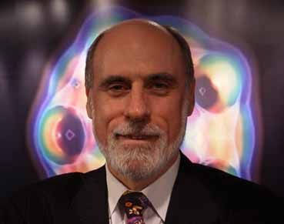
Claims
Complex, reliable, secure,
Software Defined Networks need
Rigorous guarantees ⇒ Modern SE Tools
Symbolic solvers handle core analysis tasks - we show this in context of Microsoft Azure.
- SDN calls for domain specific logics and solvers.
PROGRAM VERIFICATION NETWORKS USEFUL SDN TOOLS
Tony Hoare
Vincent Cerf

Slide 31

The Hype, Buzz & Opportunity
Software Defined Networking
Programmable Routers & Controllers: OpenFlow, P4
Network Function Virtualization
Virtualization layer for consolidating services
Huge growth in Azure Cloud
19+ regions, 10K new customers/week, 10% growth MoM, 30T obj, 4.4+ B$ rev.
Emerging commodity technologies
Improved Software tools

Slide 32



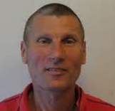
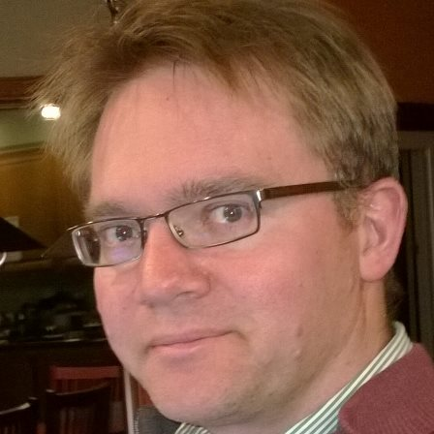
Confluence
Software Defined
Networking
Mooly Sagiv
Karthick Jayaraman
George Varghese
Software
Engineering
Foundations

Slide 33

A Cloud run by Masters of Complexity
Arcane Systems and Languages
Masters of Complexity
Cloud
Explosion

Slide 34
SecGuru

Slide 35

A Cloud Harnessed by Logic/SE
Monitoring at Scale
Cloud
Explosion

Slide 36
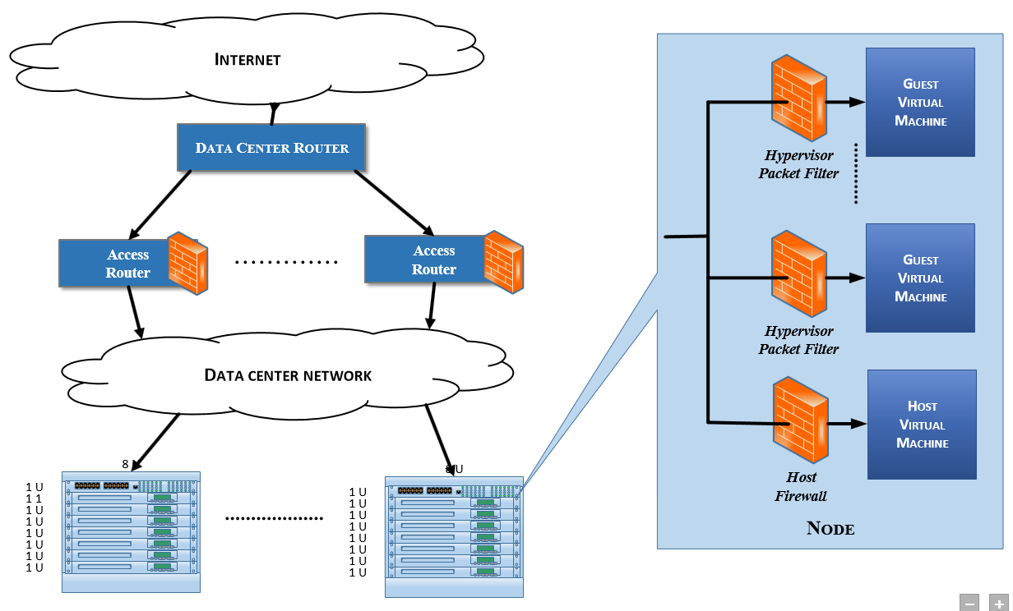
A Data-center Architecture
Policy
Policy
Policy
Policy
Policy
Policy
Policy
Policy

Slide 37
Access Control
Contract:
DNS ports on DNS servers are accessible from tenant devices over both TCP and UDP.
Contract:
The SSH ports on management devices are inaccessible from tenant devices.

Slide 38
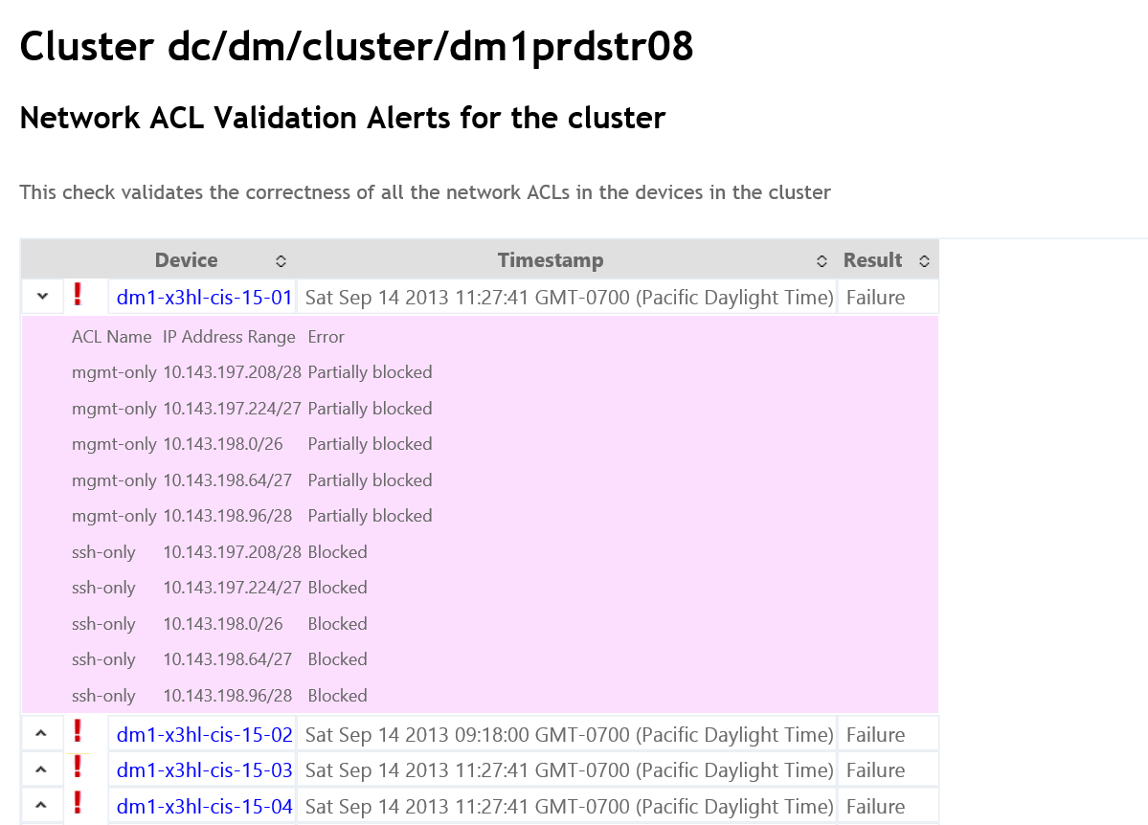
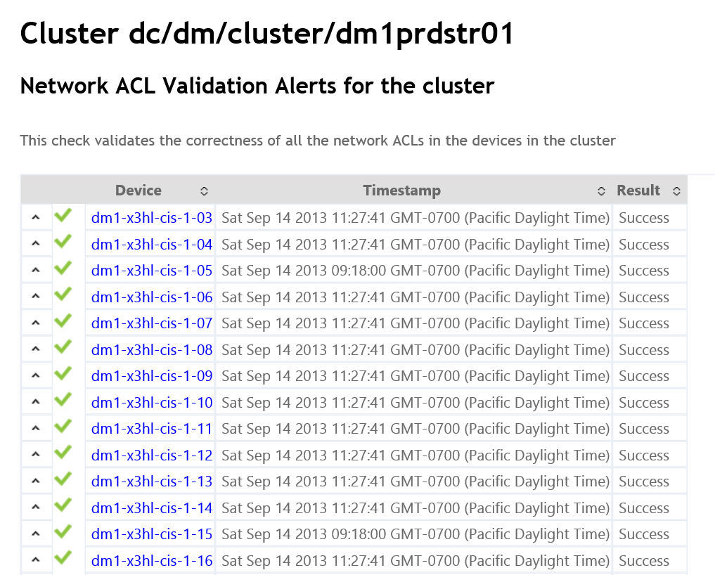
SecGuru in WANetmon
40,000 ACL checks per month
Each check 50-200ms
20 bugs/month (mostly for build-out)

Slide 39
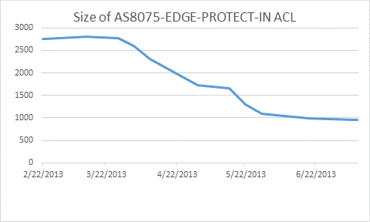
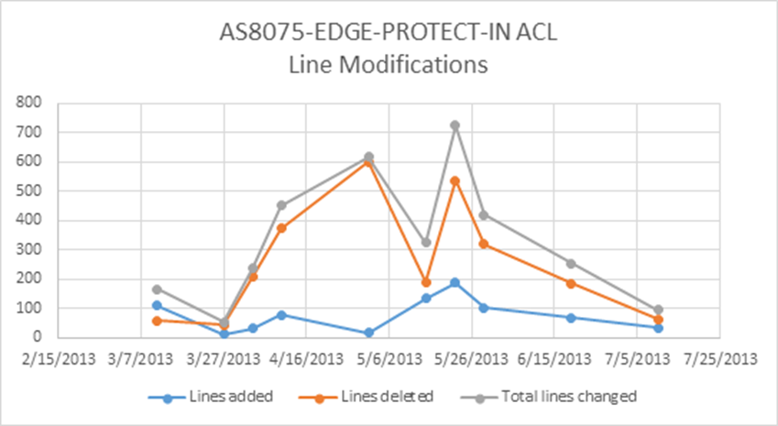
SecGuru for GNS edge ACLs
Regression test suite + SecGuru check correctness of Edge ACL prior to deployment
Edge ACL
Regression
Contracts
SecGuru
2700+ to 1000 ACLs
Edge ACL
Regression
Contracts
SecGuru
Stable state
Edge ACL
Several major
Edge ACL pushes
no major impact
on any services

Slide 40
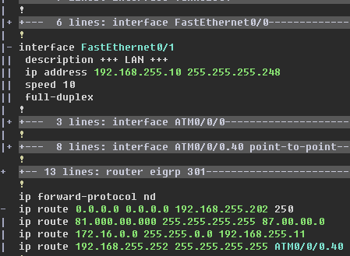

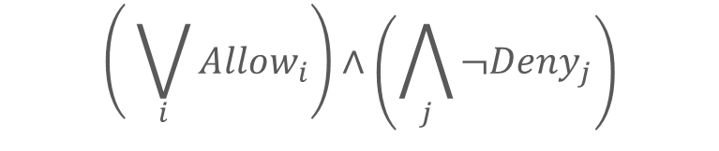
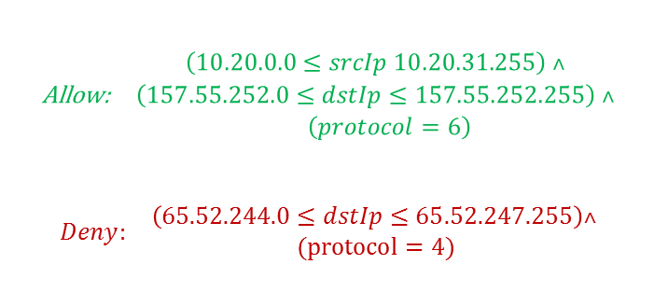
Policies as Logical Formulas
Precise Semantics as
formulas
Traditional Low level of Configuration network managers use
$$\begin{matrix}\text{Allow}\text{:} & \begin{aligned}\left(10.20.0.0≤srcIp 10.20.31.255\right) ˄ \\ \left(157.55.252.0≤dstIp≤157.55.252.255\right) ˄ \\ \left(protocol=6\right)\end{aligned}\end{matrix}$$
$$\begin{matrix}Deny: & \begin{aligned}\left(65.52.244.0≤dstIp≤65.52.247.255\right)˄ \\ (protocol=4) \end{aligned}\end{matrix}$$
Combining semantics
Contracts/Policies
$$\left( \bigvee_{i}{Allow_{i}}\right)∧\left(\bigwedge_{j}{¬Deny_{j}}\right)$$
Semantic
Diffs

Slide 41

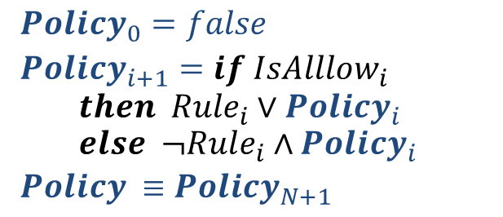
Policies as Logical Formulas
Precise Semantics as
formulas
Traditional Low level of Configuration network managers use
$$\begin{matrix}\text{Allow}\text{:} & \begin{aligned}\left(10.20.0.0≤srcIp 10.20.31.255\right) ˄ \\ \left(157.55.252.0≤dstIp≤157.55.252.255\right) ˄ \\ \left(protocol=6\right)\end{aligned}\end{matrix}$$
$$\begin{matrix}Deny: & \begin{aligned}\left(65.52.244.0≤dstIp≤65.52.247.255\right)˄ \\ (protocol=4) \end{aligned}\end{matrix}$$
Combining semantics
Contracts/Policies
$Policy_{0}=false$
$Policy_{i+1}=if IsAlllow_{i}$ $$then Rule_{i}∨Policy_{i} \\ else ¬Rule_{i}∧Policy_{i}$$
$Policy ≡Policy_{N+1}$
Semantic
Diffs

Slide 42
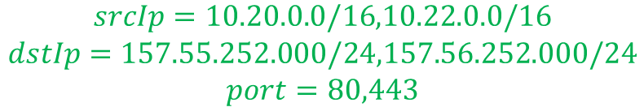
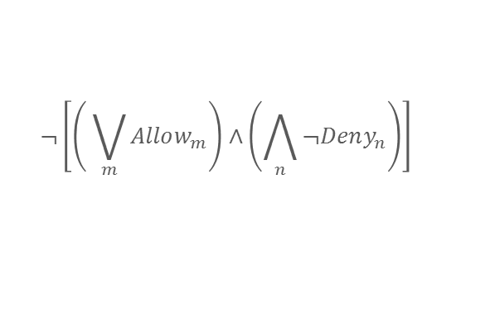
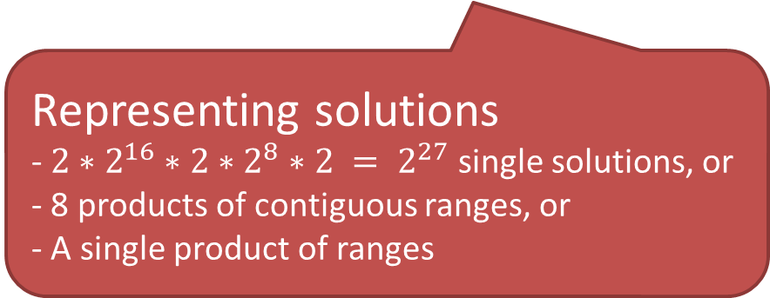
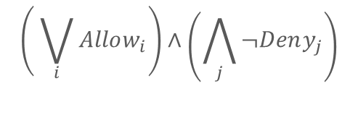
From one violation to all violations
$$\left( \bigvee_{i}{Allow_{i}}\right)∧\left(\bigwedge_{j}{¬Deny_{j}}\right)$$
$$¬\left[\left( \bigvee_{m}{Allow_{m}}\right)∧\left(\bigwedge_{n}{¬Deny_{n}}\right)\right]$$
Semantic
Diffs
$$\begin{matrix}srcIp=10.20.0.0/16,10.22.0.0/16 \\ dstIp=157.55.252.000/24,157.56.252.000/24 \\ port=80,443\end{matrix}$$
Representing solutions
-$2∗2^{16}∗2∗2^{8}∗2 = 2^{27}$single solutions, or
- 8 products of contiguous ranges, or
- A single product of ranges
dstIp
dstIp
SecGuru contains optimized algorithm for turning single solutions into all (product of ranges)
srcPort
srcIp
srcIp

Slide 43
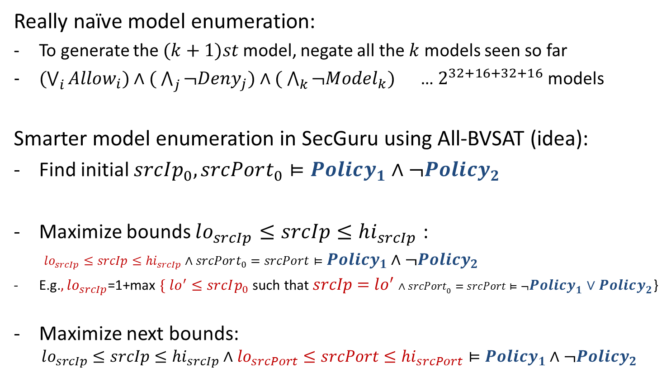
All-BVSAT: A compact model enumeration
Really naïve model enumeration:
To generate the $(k+1)st$model, negate all the $k$ models seen so far
$(\bigvee_{i}{Allow_{i})∧( \bigwedge_{j}{¬Deny_{j})∧( \bigwedge_{k}{¬Model_{k}) }}}$ … $2^{32+16+32+16}$ models
Smarter model enumeration in SecGuru using All-BVSAT (idea):
Find initial $srcIp_{0},srcPort_{0}⊨Policy_{1}∧¬Policy_{2}$
Maximize bounds $lo_{srcIp}≤srcIp≤hi_{srcIp}$ : $lo_{srcIp}≤srcIp≤hi_{srcIp}∧srcPort_{0}=srcPort⊨Policy_{1}∧¬Policy_{2}$
E.g.$, lo_{srcIp}$=1+max $\{ lo^{′}≤srcIp_{0}$such that $srcIp=lo^{′}∧srcPort_{0}=srcPort⊨¬Policy_{1}∨Policy_{2}$}
Maximize next bounds: $lo_{srcIp}≤srcIp≤hi_{srcIp}∧lo_{srcPort}≤srcPort≤hi_{srcPort}⊨Policy_{1}∧¬Policy_{2}$
Notes:
Explain in detail about the unsatisfiability check in Z3

Slide 44
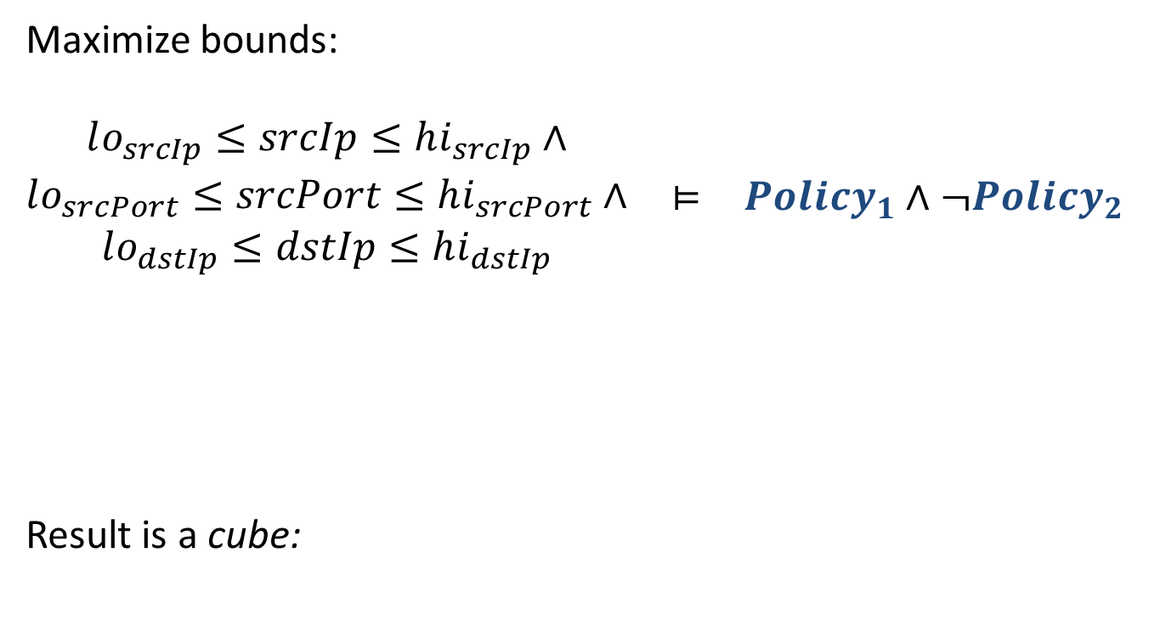
All-BVSAT: A compact model enumeration
Maximize bounds: $\begin{matrix}\begin{aligned}lo_{srcIp}≤srcIp≤hi_{srcIp}∧ \\ lo_{srcPort}≤srcPort≤hi_{srcPort}∧ \\ lo_{dstIp}≤dstIp≤hi_{dstIp}\end{aligned} & ⊨ & Policy_{1}∧¬Policy_{2}\end{matrix}$
Result is a cube:
dstIp
srcPort
srcIp
Notes:
Explain in detail about the unsatisfiability check in Z3

Slide 45
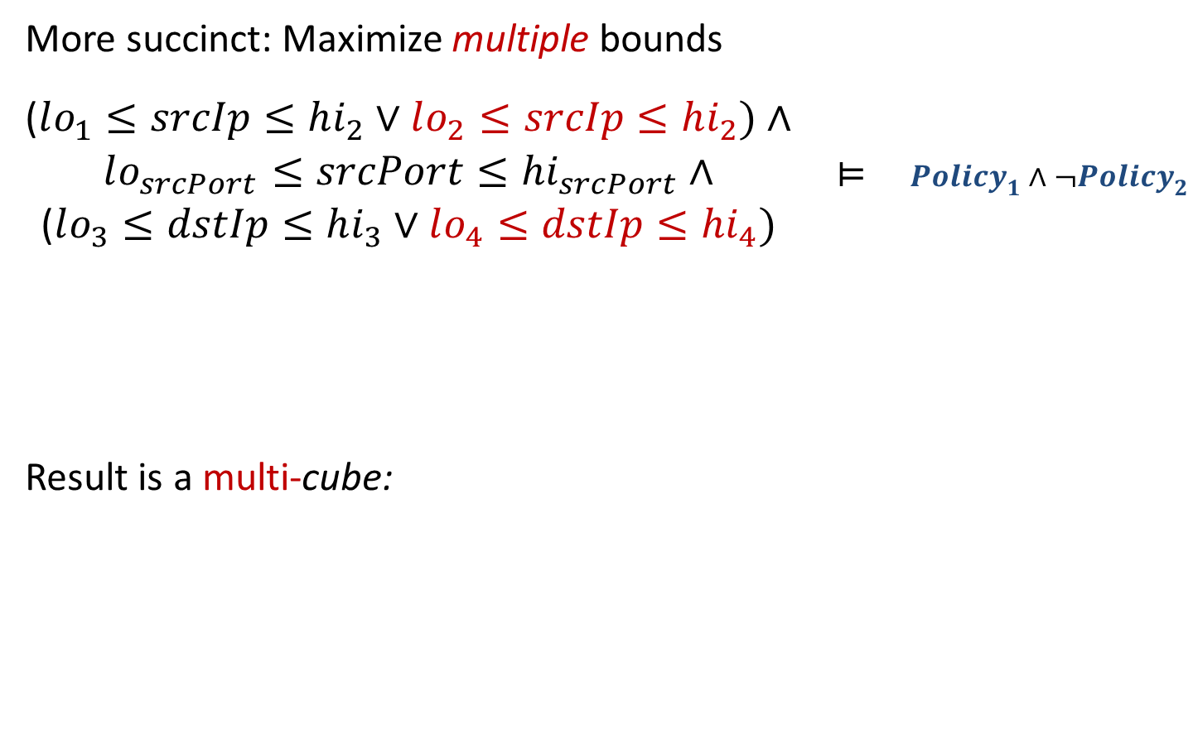
All-BVSAT: A compact model enumeration
More succinct: Maximize multiple bounds
$\begin{matrix}\begin{aligned}\text{(}lo_{1}≤srcIp≤hi_{2}∨lo_{2}≤srcIp≤hi_{2})∧ \\ lo_{srcPort}≤srcPort≤hi_{srcPort}∧ \\ \text{(}lo_{3}≤dstIp≤hi_{3}∨lo_{4}≤dstIp≤hi_{4})\end{aligned} & ⊨ & Policy_{1}∧¬Policy_{2}\end{matrix}$
Result is a multi-cube:
dstIp
dstIp
srcPort
srcIp
srcIp
Notes:
Explain in detail about the unsatisfiability check in Z3

Slide 46
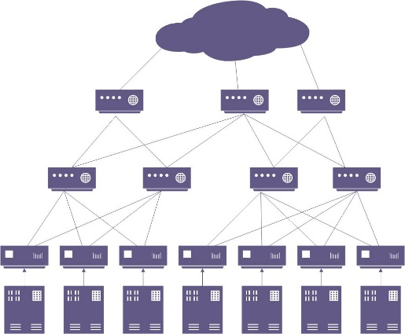



Network Verification: Opportunities
Verifying Backup Equivalence
Verifying Flow Properties
Verifying Controllers and middle-boxes
Verifying SDN Compilers (P4/OpenFlow)
Synthesizing Control Plane

Slide 47
Summary
Many program analysis queries contain logic component.
SMT solvers provide well suited, general purpose, engines.
SMT technologies:
SAT + Theory Solvers + Theory Combination
Network Verification as a timely domain

Slide 48
Calculus and Solvers
Application | Calculus | Solver
SecGuru: Access Control Routing Validation Static configurations for Border Gateway Protocol | Satisfiability Modulo Theories for Bit-vectors | SAT
Checking beliefs in networks | Network Optimized Datalog | Datalog for Header Spaces
Verifying SDN controllers | Quantified logical formulas | Instantiation based reasoning

